Slide 1

Comarch Selfcare Staż 2022
Google Analytics + Google Optimize + CMS
Marta Fiedorowicz, Krzysztof Wołkonowski, Jakub Walaszek

Slide 2
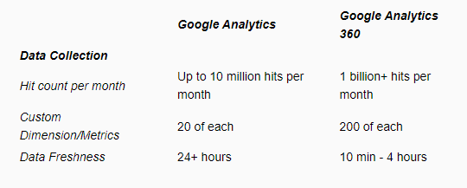
How to add? How much this cost?
How to add it to Angular project?
Google Account
ngx-google-analytics
How much does it cost?
Freemium
Paid version 12,500$/month

Slide 3
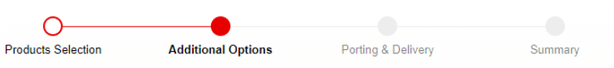
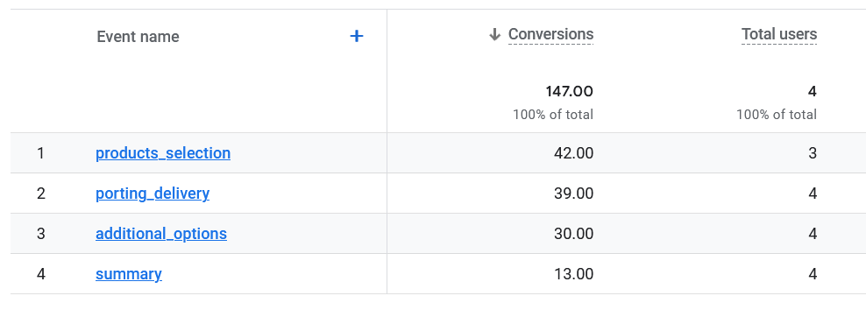
GA in Eshop
Conversions

Slide 4
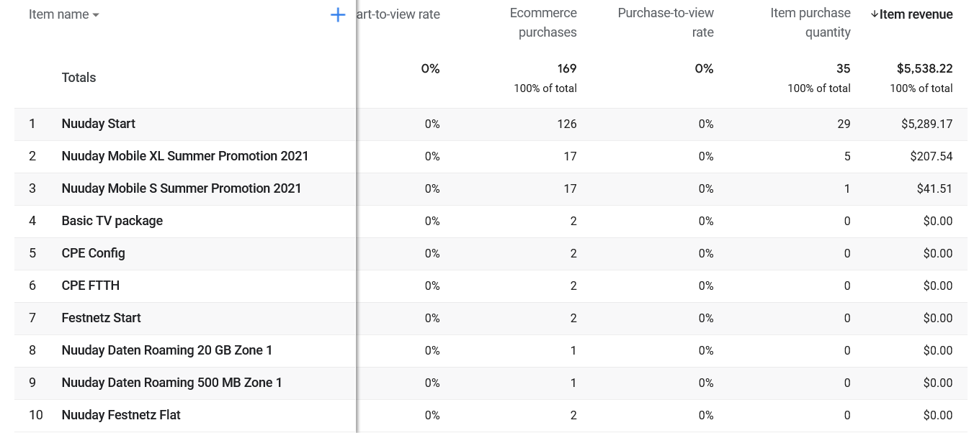
GA Monetization

Slide 5
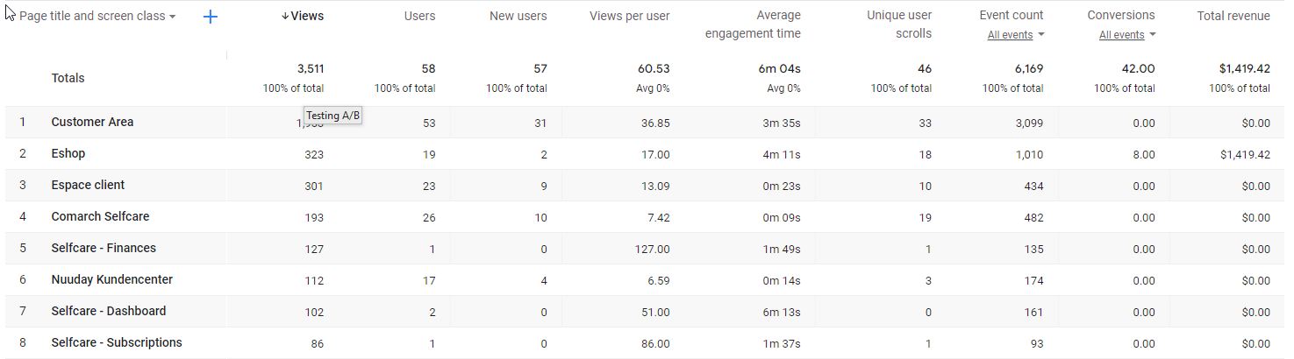
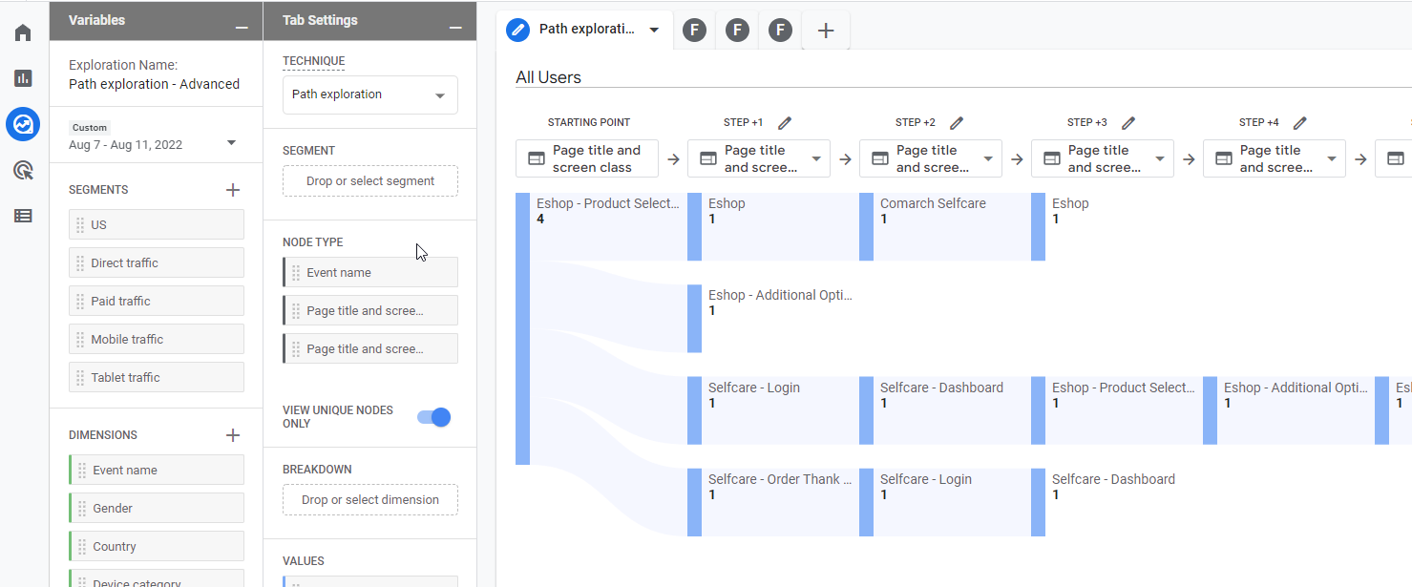
GA in SelfCare
User flow

Slide 6
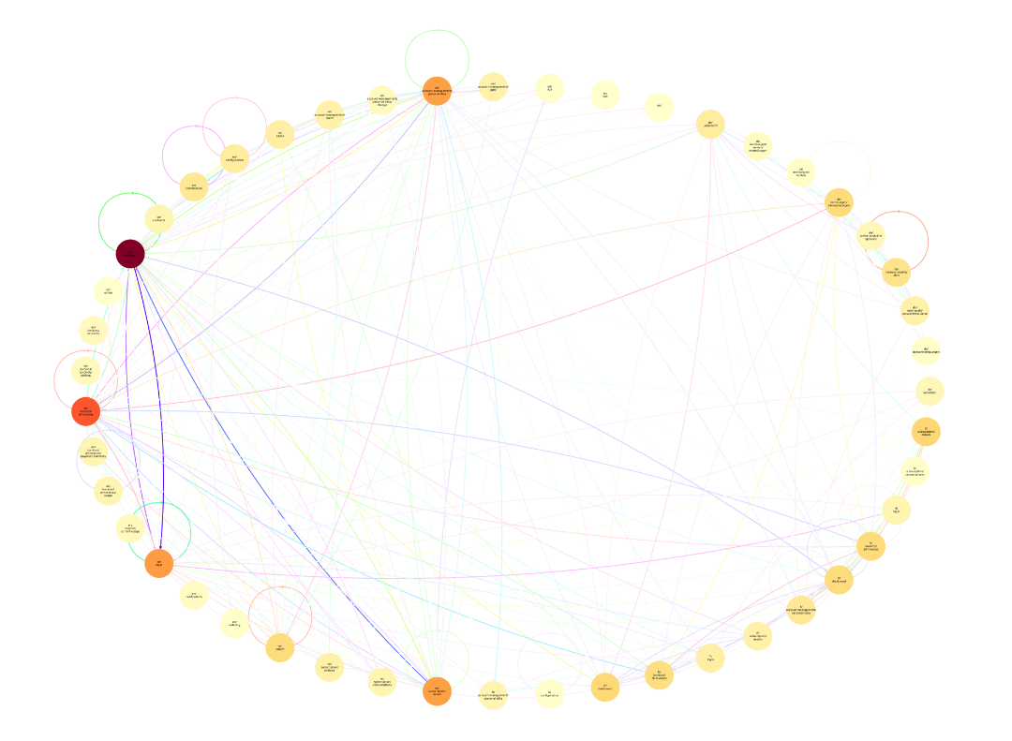
Python processing
User flow with raw data

Slide 7
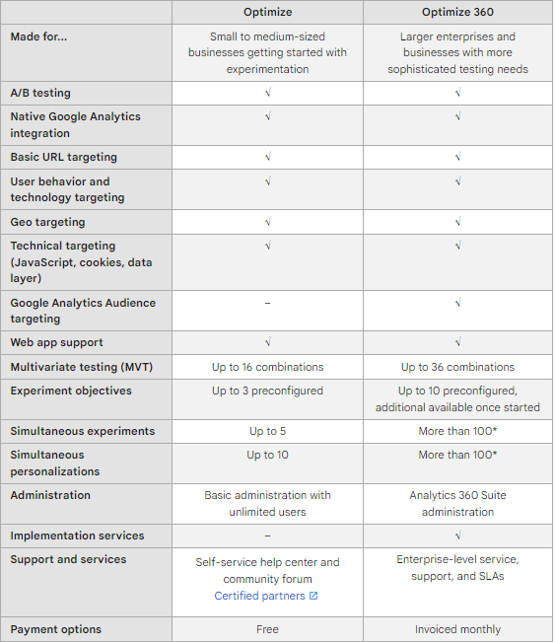
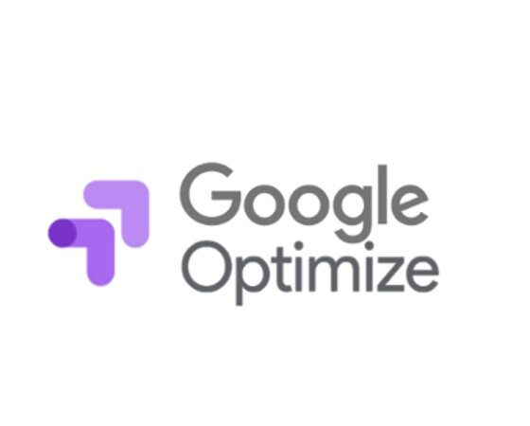
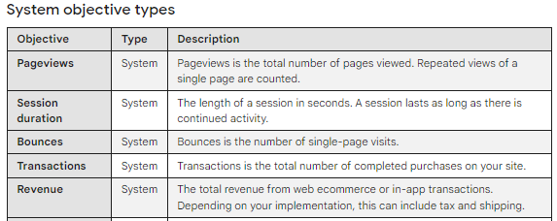
Testing A/B
Google Optimize

Slide 8
Two disjoint paths in Google Optimize
Editing in Angular
Editing from interface
solid
unstable

Slide 9
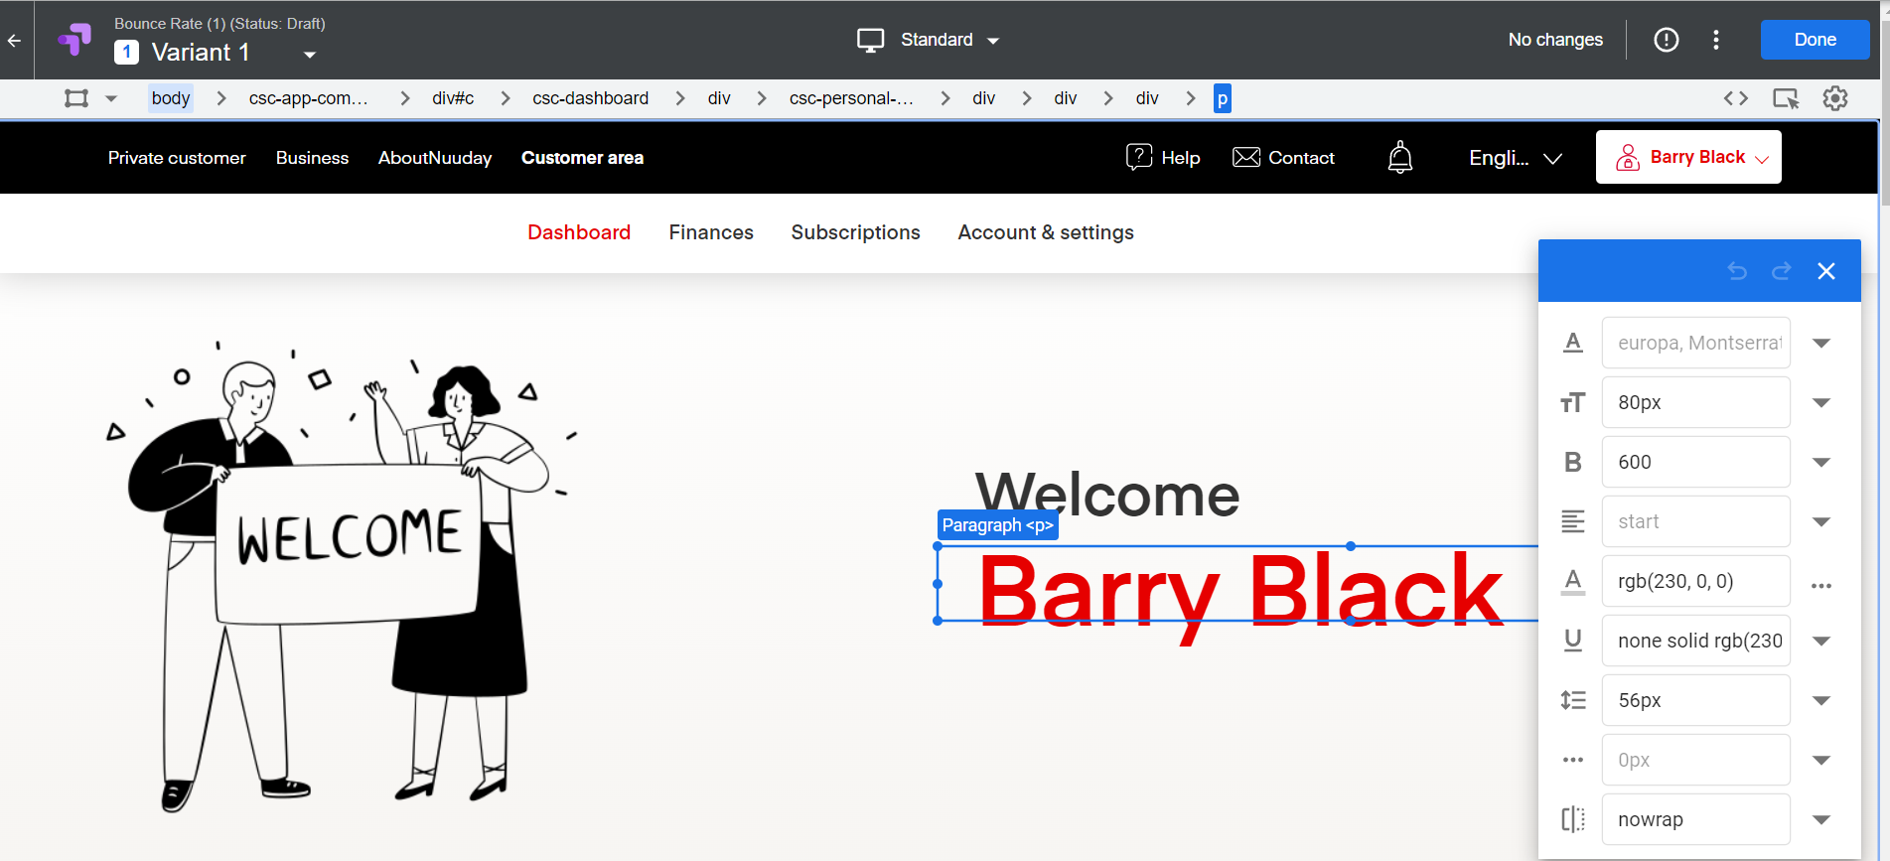
Google Optimize Editor

Slide 10
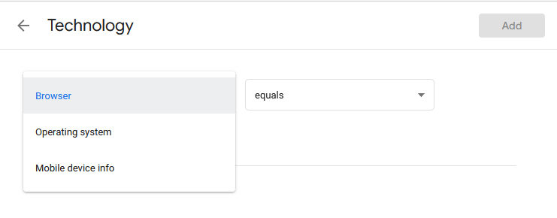
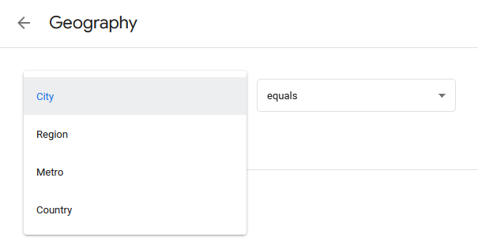
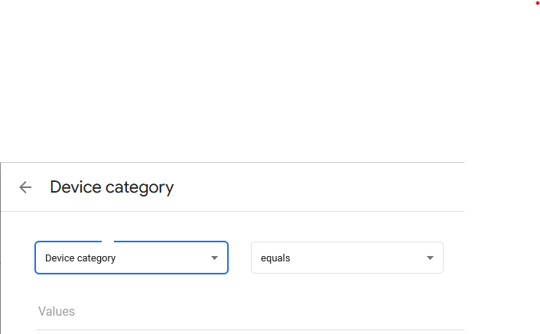
Audience Targeting (only from editor)
We can target only the whole experiment, not just a single variant

Slide 11
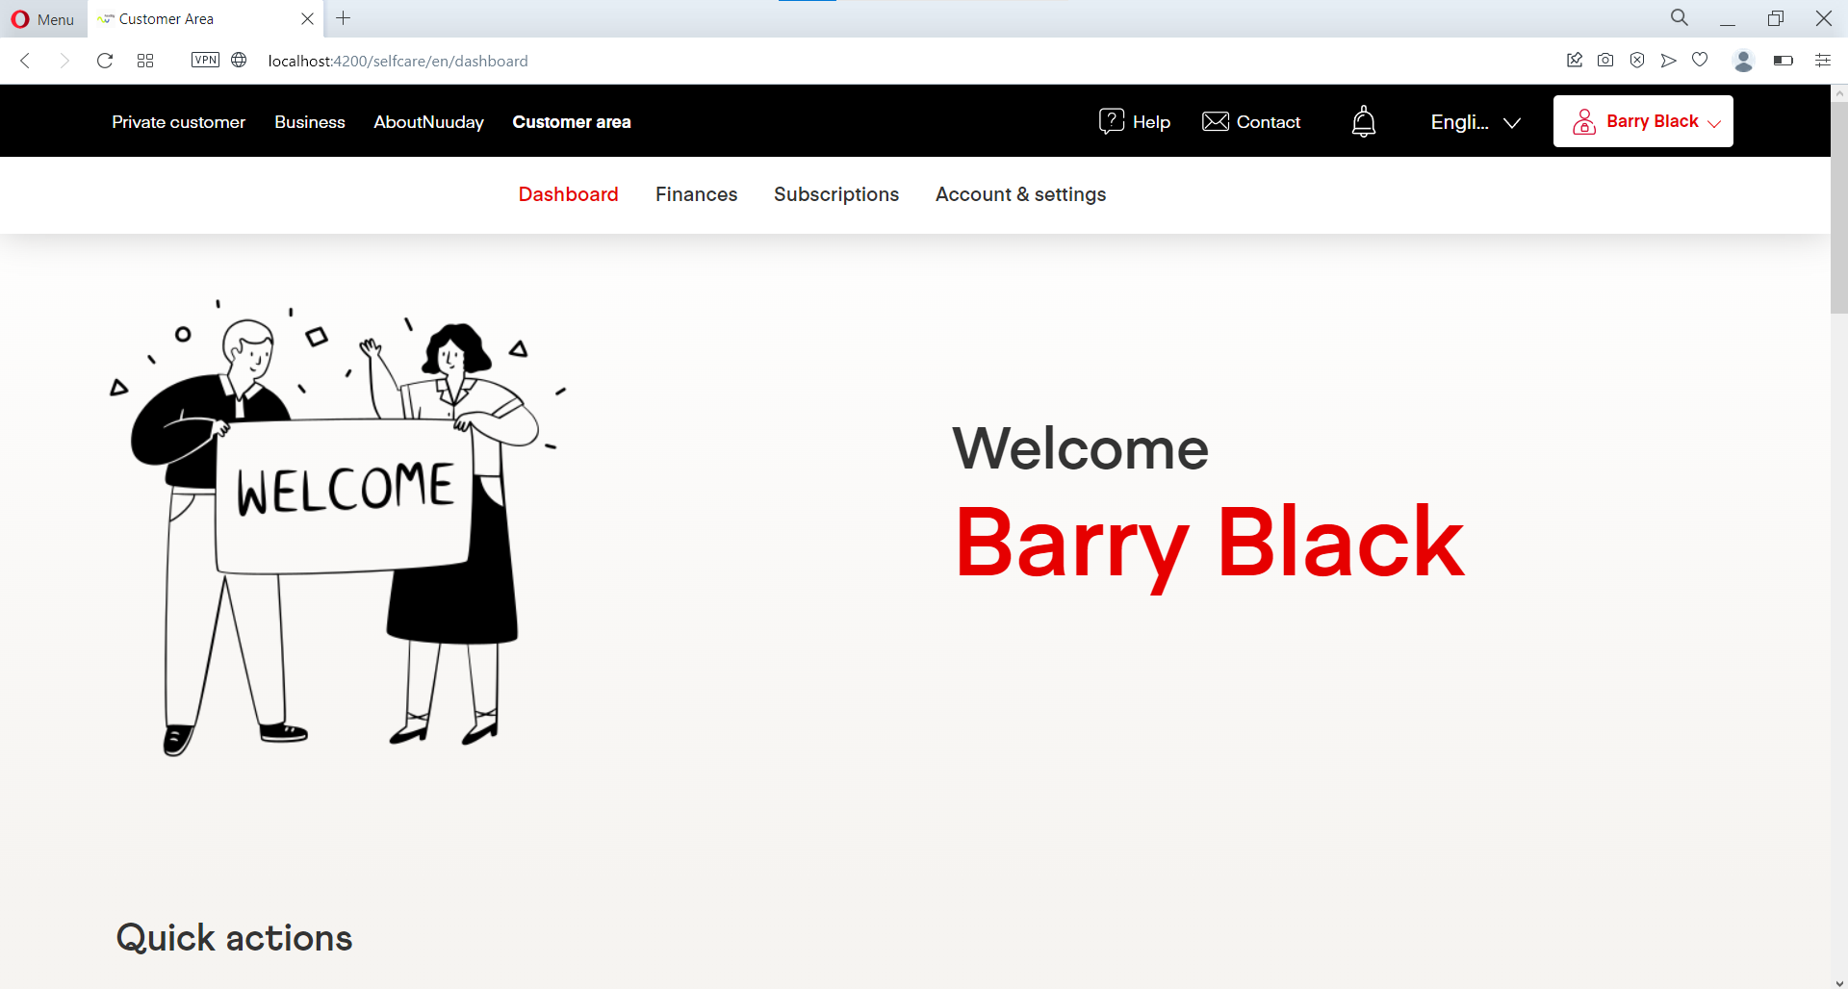
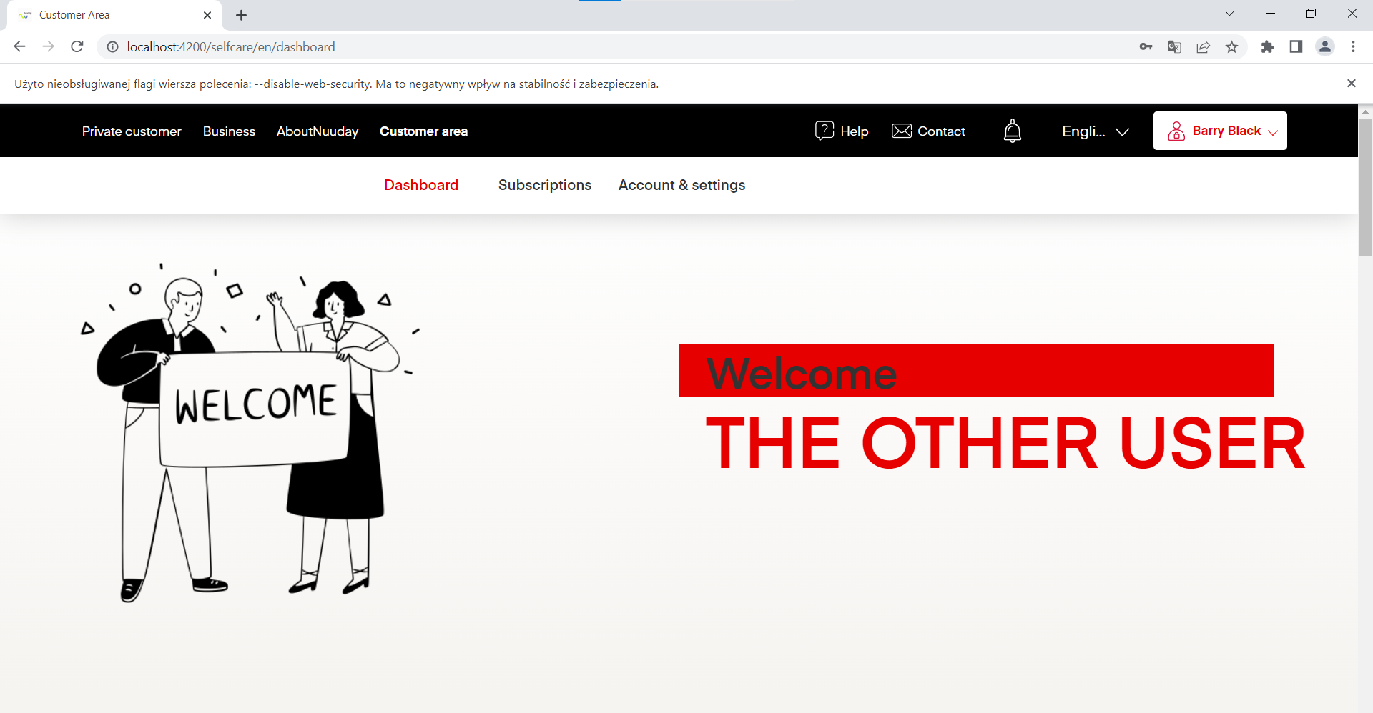
Audience Targeting on examples
Browser

Slide 12
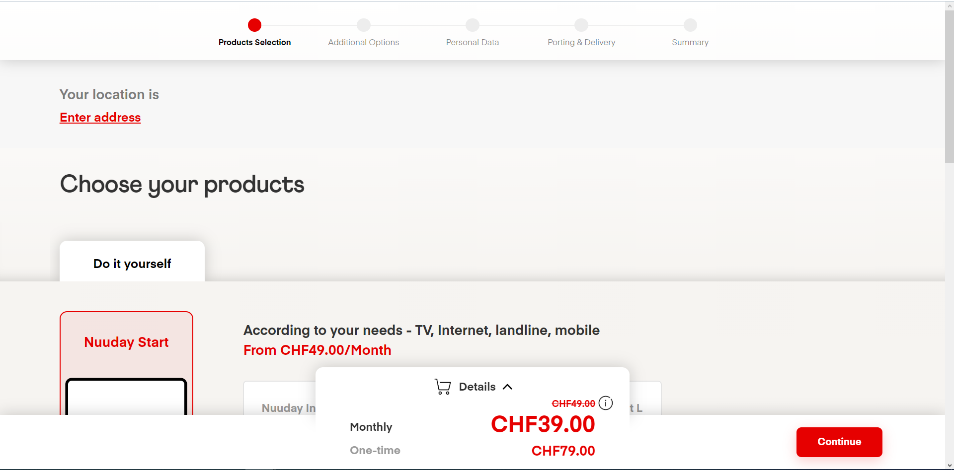
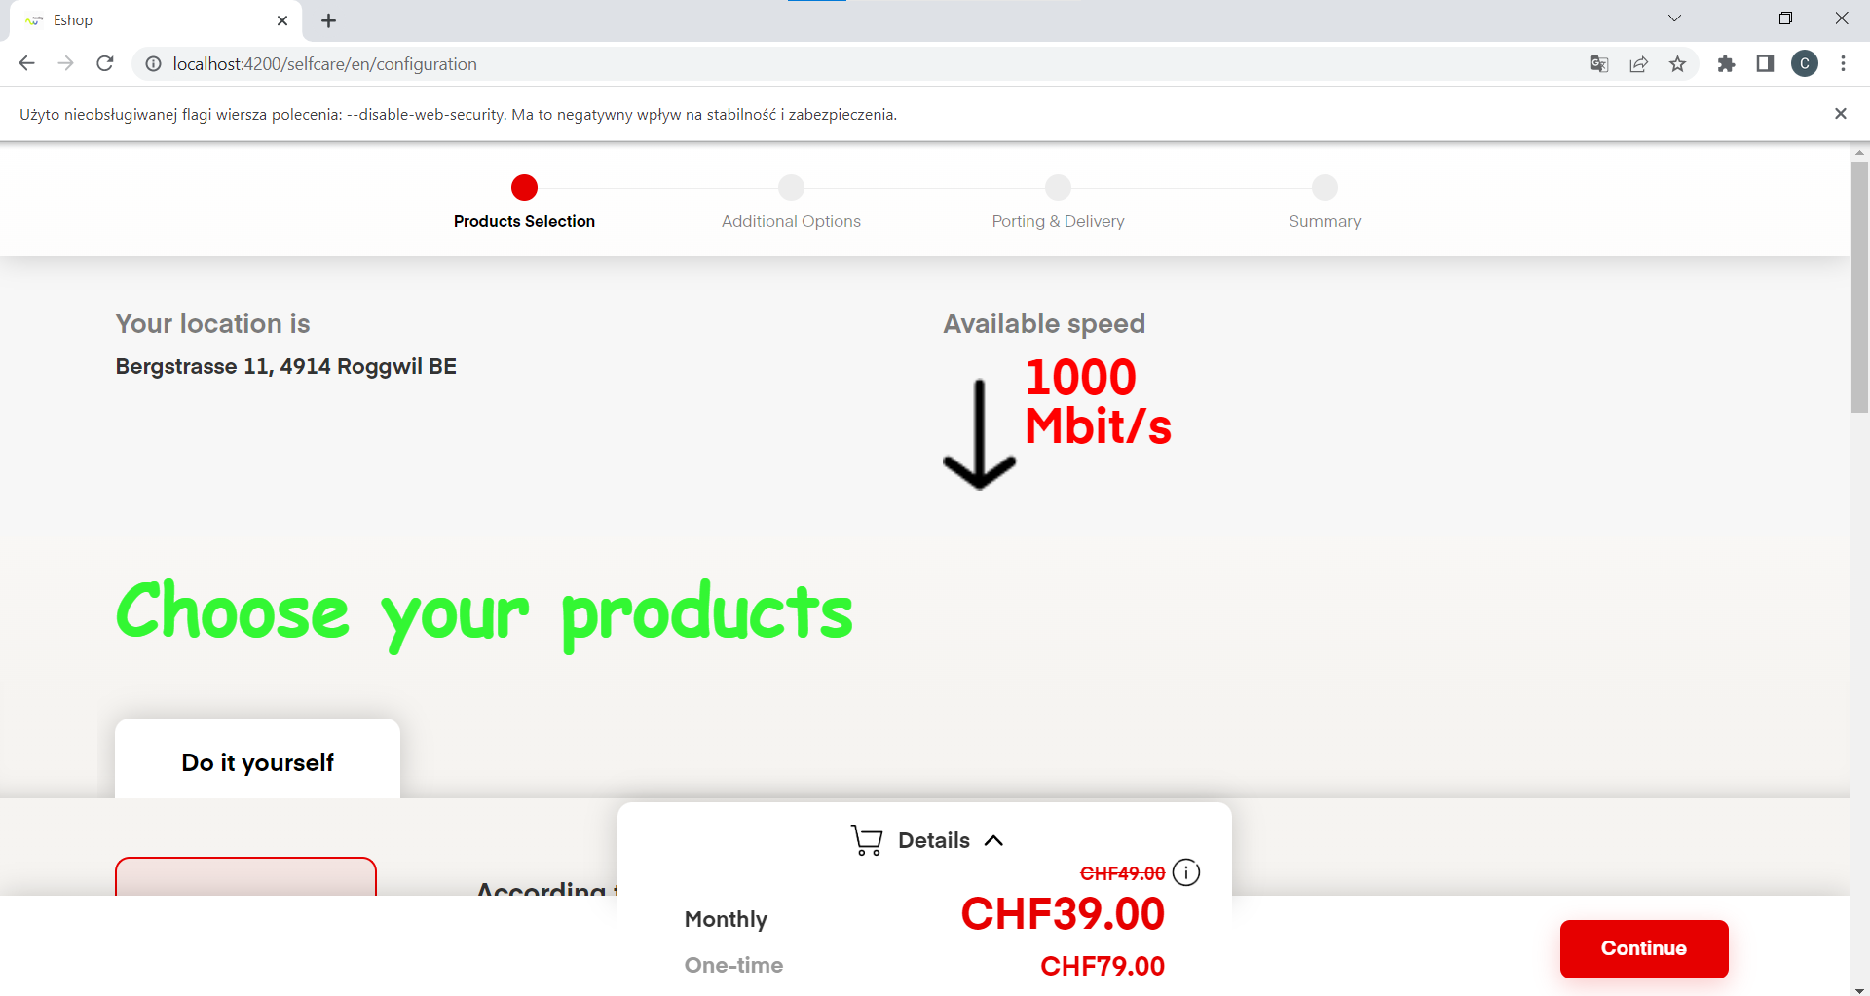
Audience Targeting on examples
Logged-in users

Slide 13
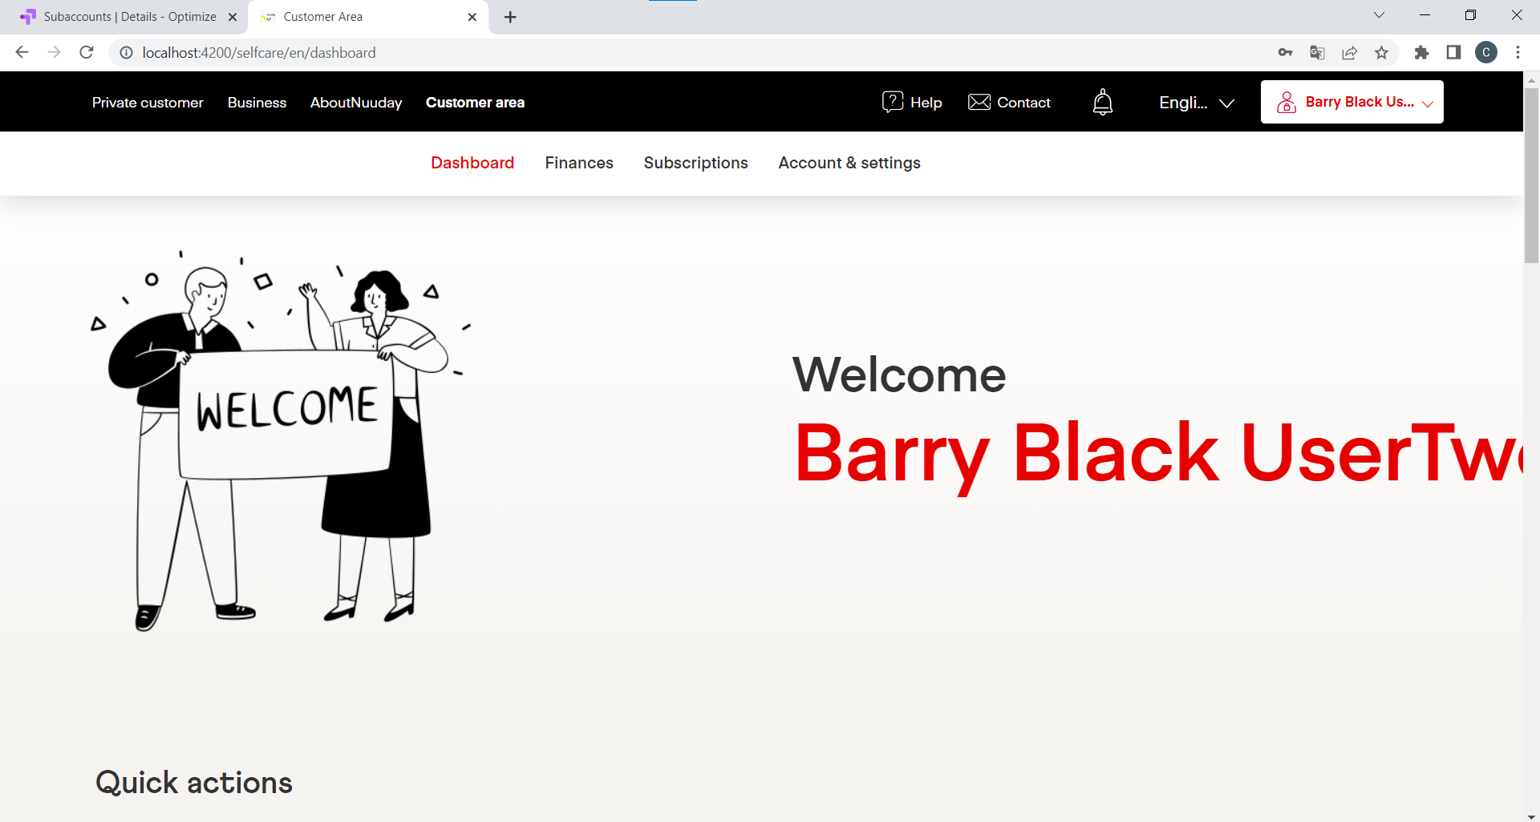
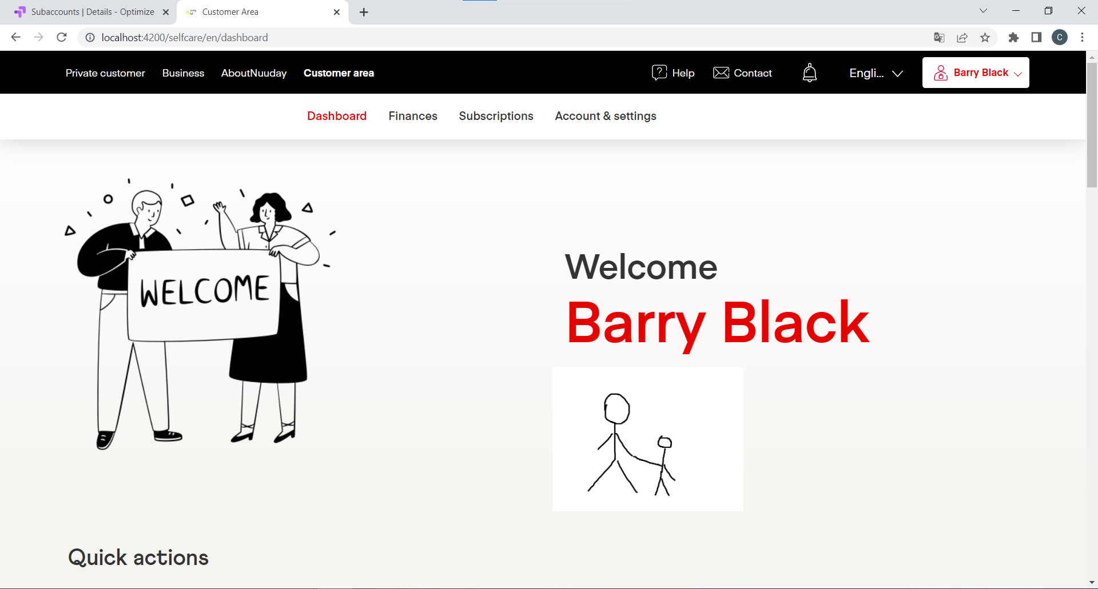
Audience Targeting on examples
Subaccounts

Slide 14
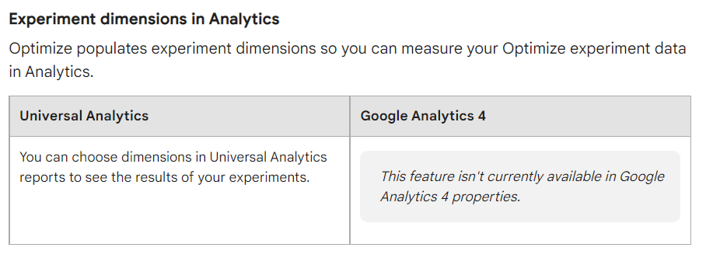
Google Optimize Beta
What will be added?
Event parameters as objectives

Slide 15
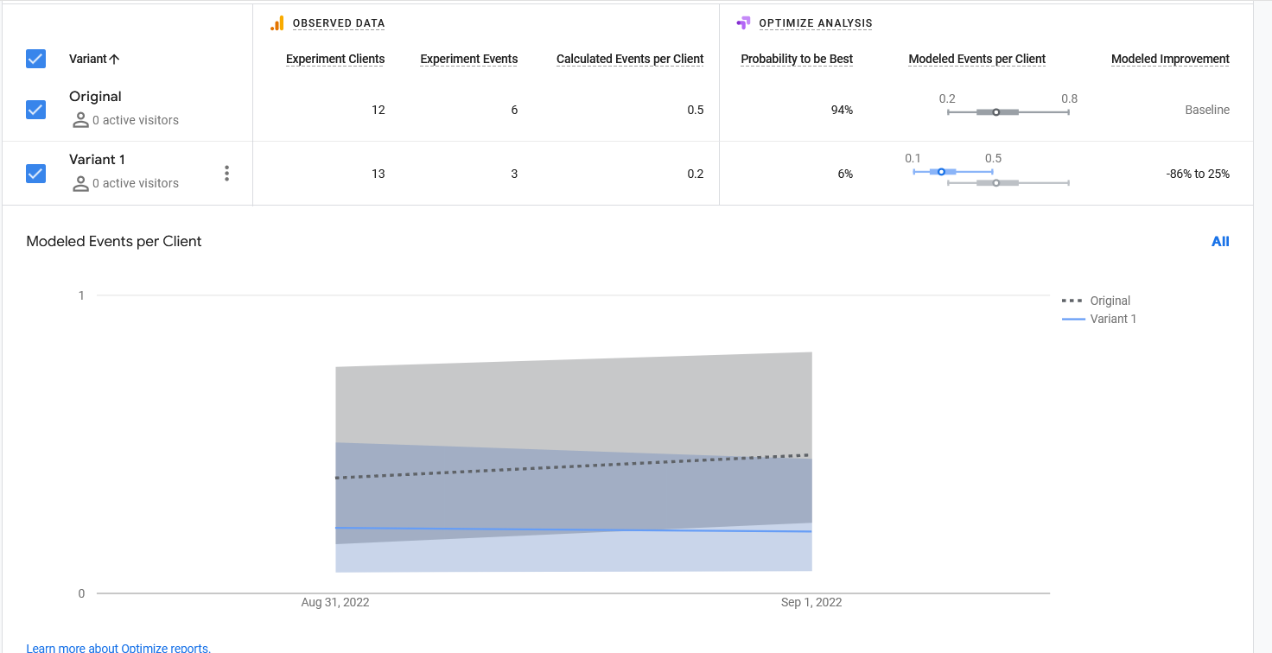
„Bounce Rate” in Google Optimize
We assume that the amount of users on first stage is uniform, thus we compare amount of users in second variant

Slide 16
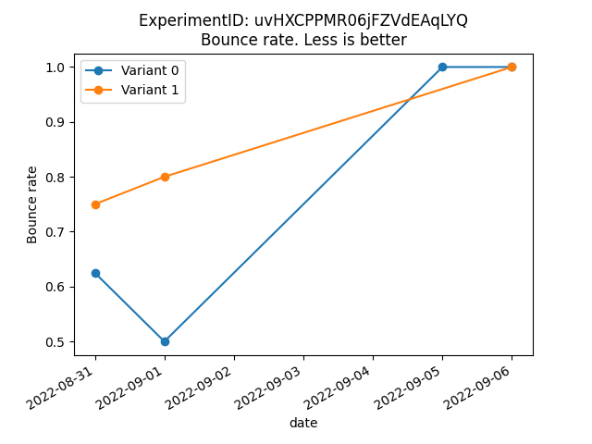
Bounce Rate in Python
We have raw amounts of users on each step, so we can calculate actual bounce rate properly.

Slide 17
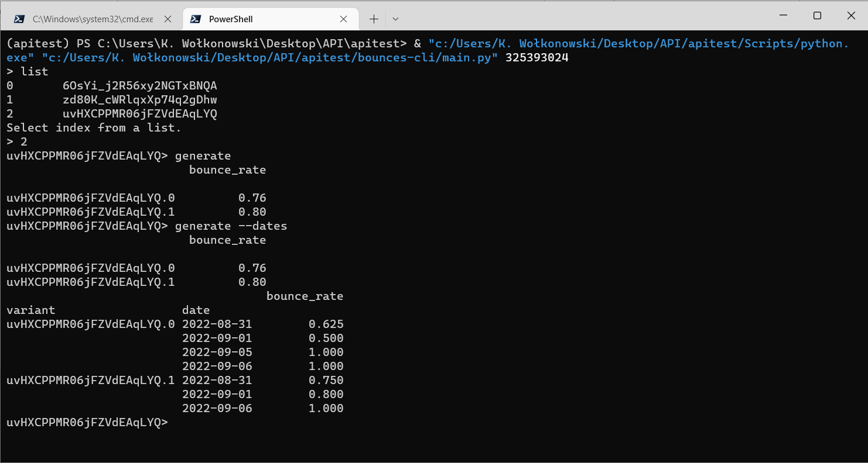
Bounce Rate in Python

Slide 18
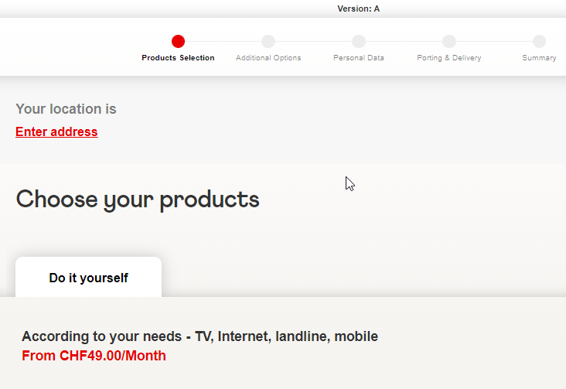
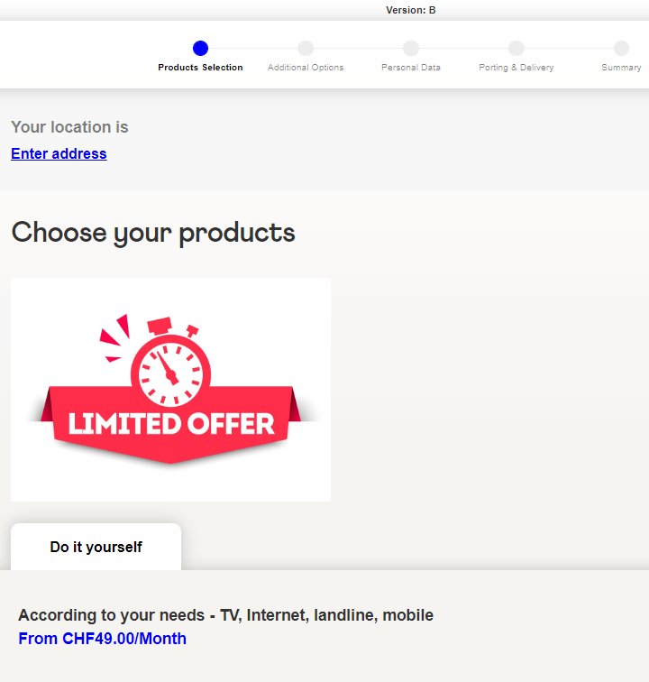
Testing A/B in SC

Slide 19
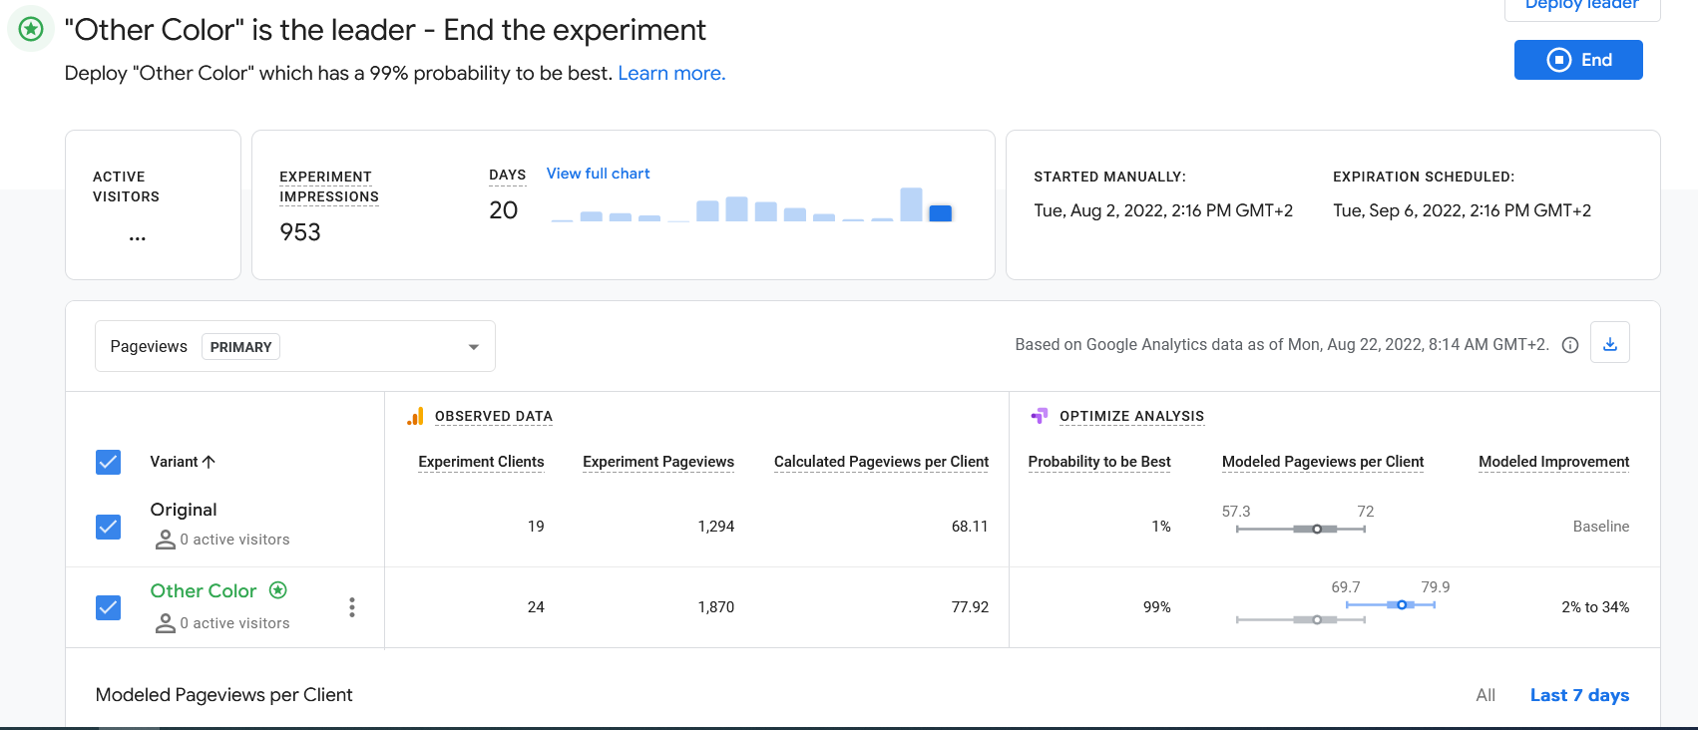
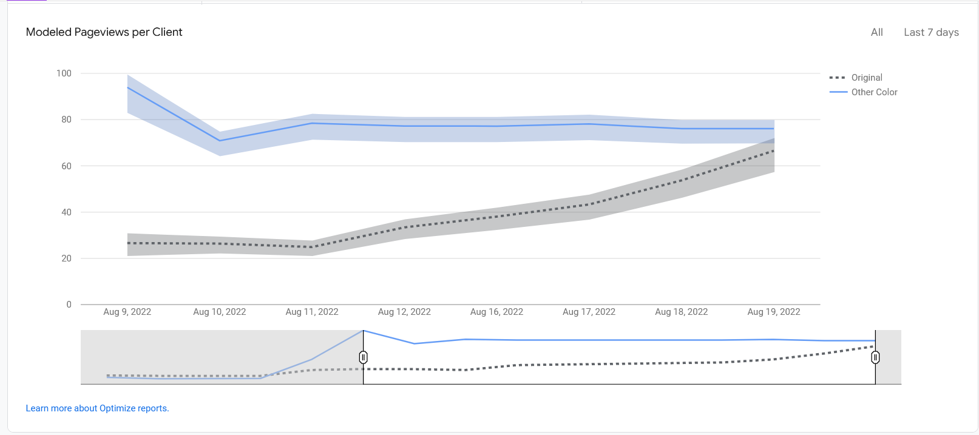
Testing A/B in SC, Pageviews

Slide 20
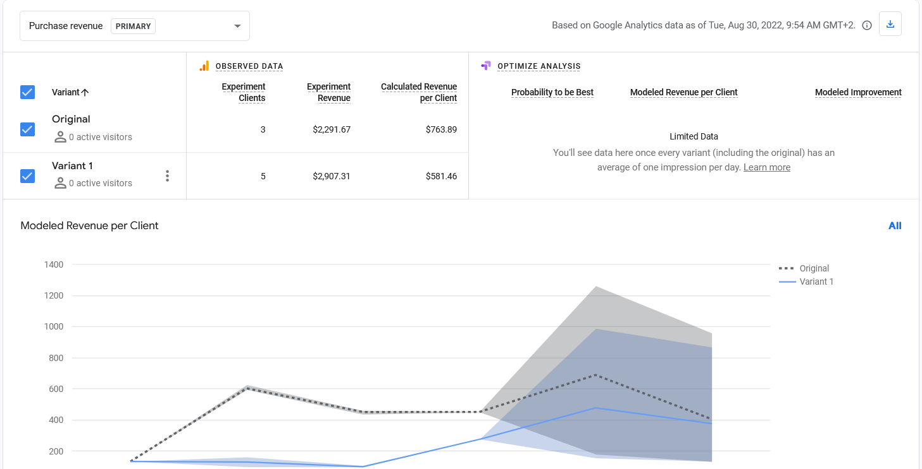
Testing A/B in SC, Revenue

Slide 21
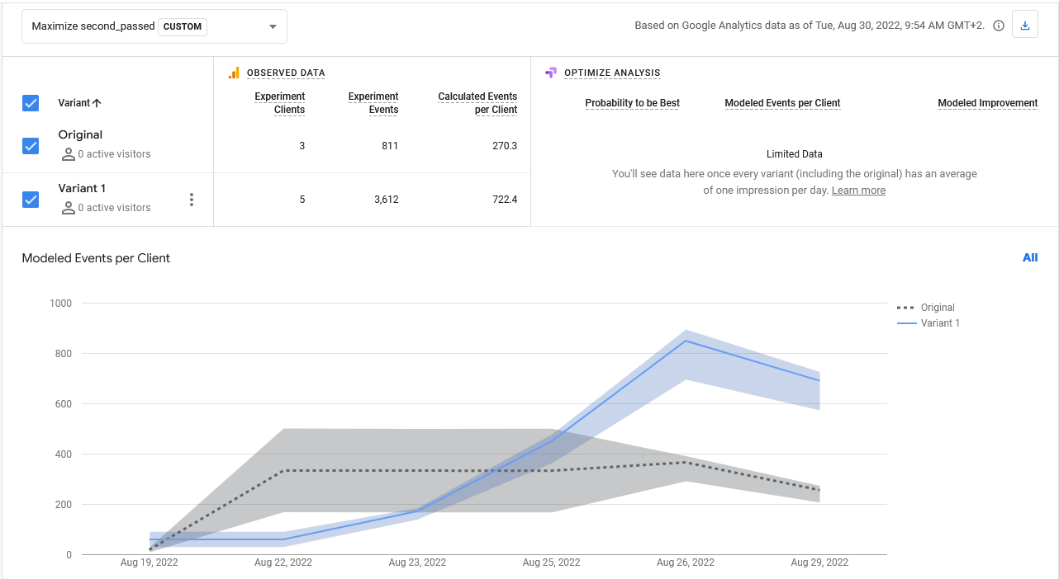
Testing A/B in SC, Time Spent

Slide 22
Summary
Google Optimize is easy tool for easy goals, like monetization or pageviews across variants
When we want to get solid, advanced and more customizable data processing we should use modern Data Science tools (e.g. Pandas) and connect to Google Analytics via Data API
Google Optimize doesn’t offer any additional data, which couldn’t be done on premises using API and proper calculations

Slide 23
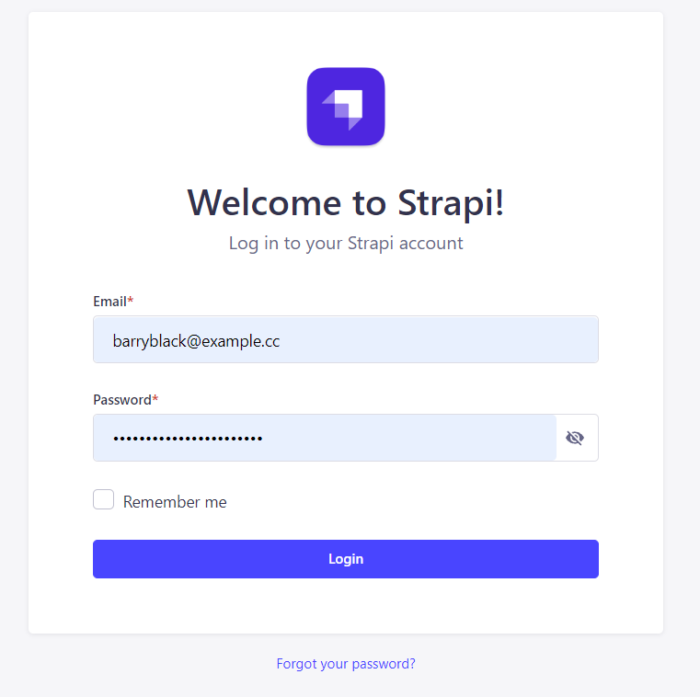
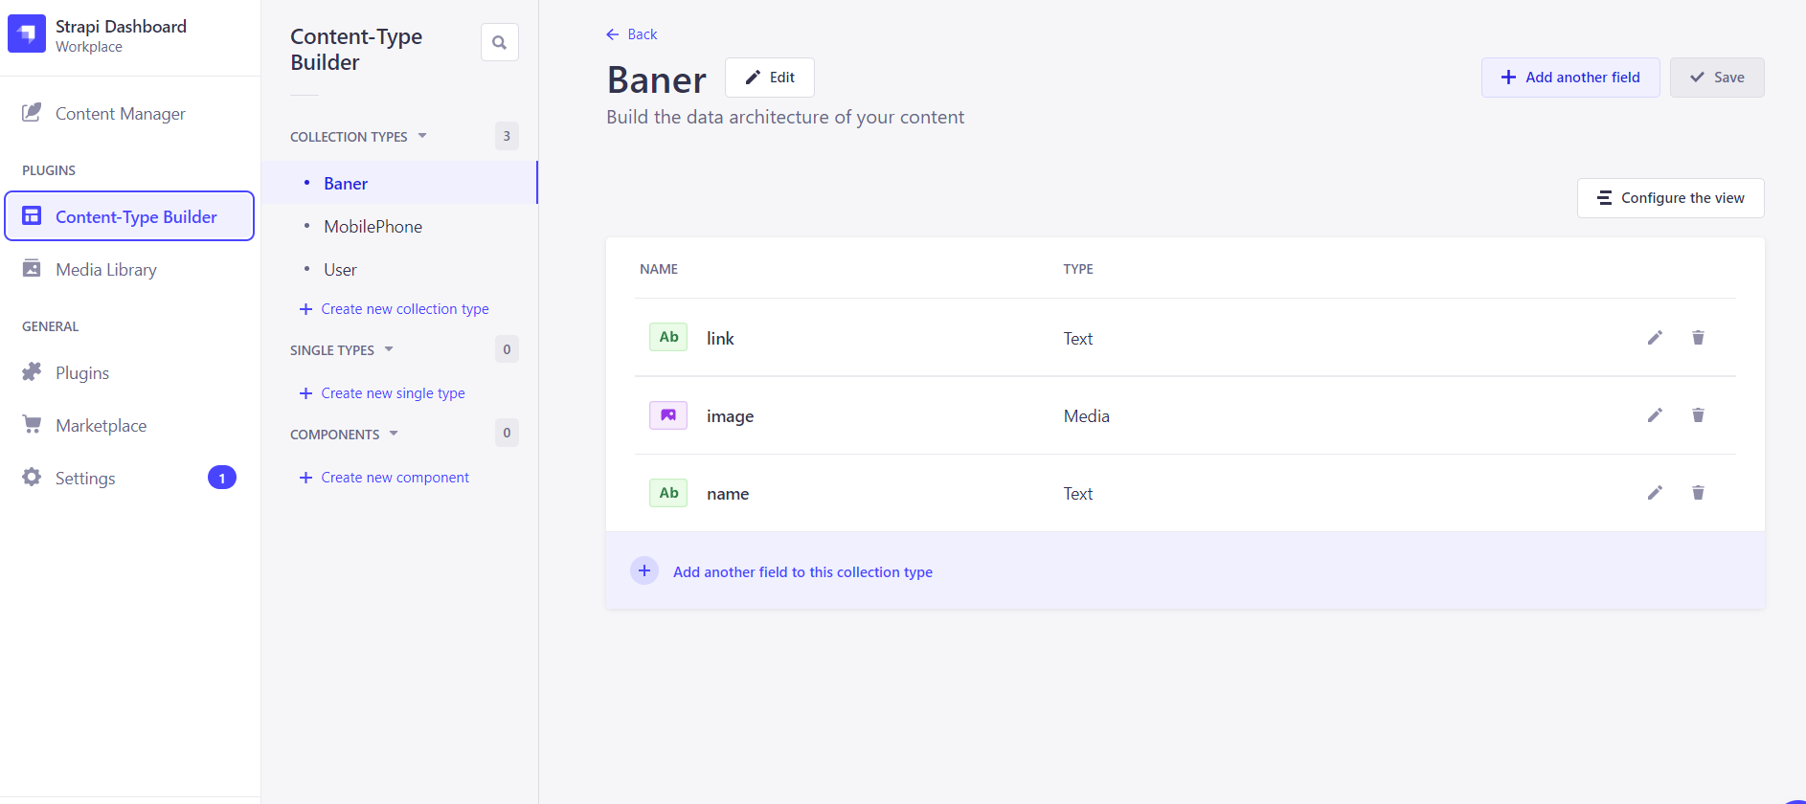
CMS Strapi
User login, roles and control

Slide 24
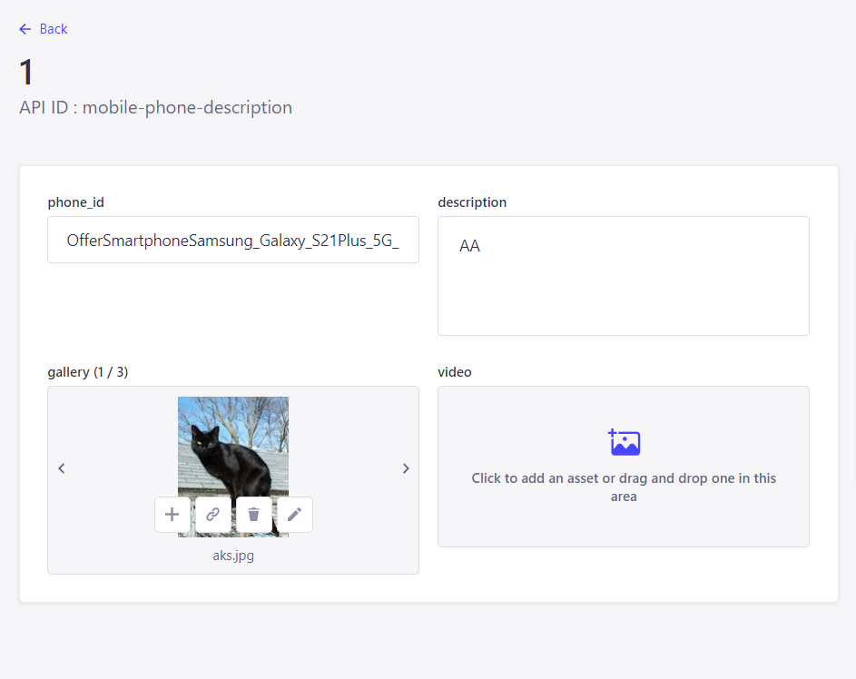
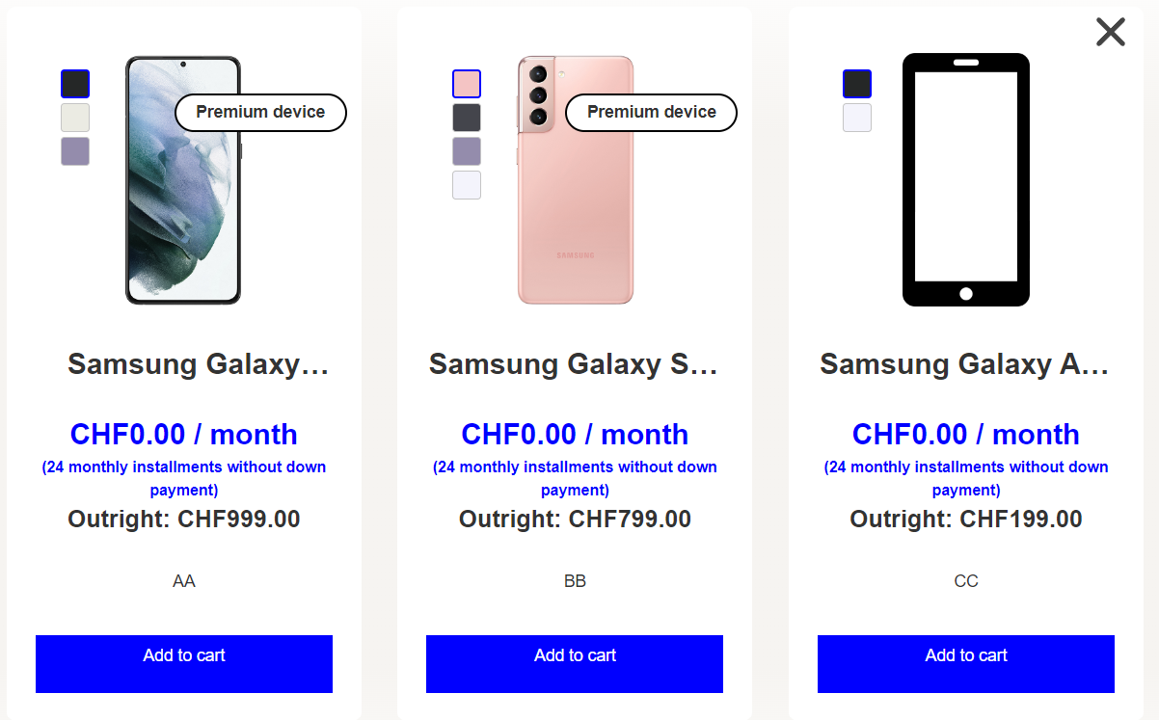
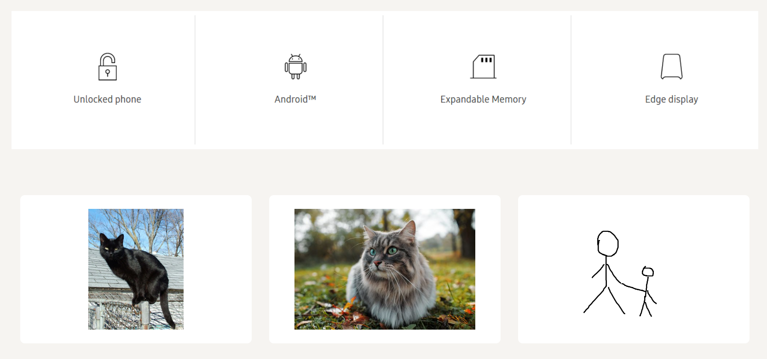
CMS - Store

Slide 25
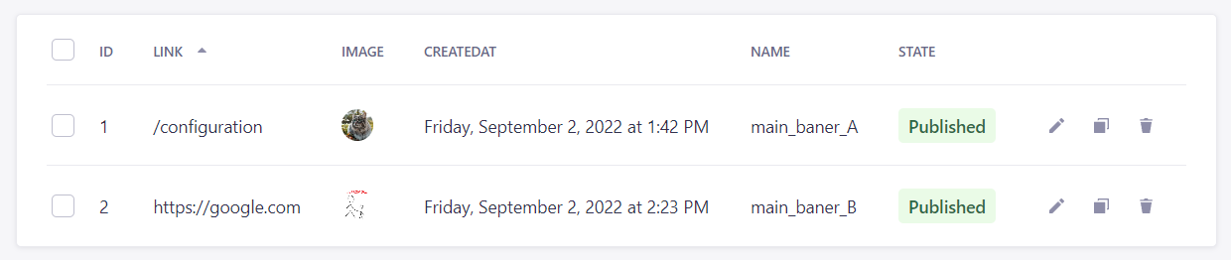


CMS A/B testing

